Slide 1
Memory-Optimized Tables
Querying at the speed of light

Slide 2












Sponsors
Gold Sponsors:
Bronze Sponsors:
Swag Sponsors:

Slide 3

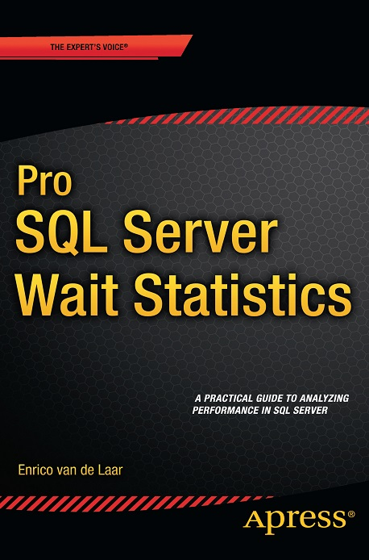


About me
Enrico van de Laar
Microsoft SQL Server MVP
Database Technology Specialist
Blogger
Author
@evdlaar
http://www.dotnine.nl
3 |

Slide 4
Agenda
Introduction to In-Memory OLTP
Limitations
Memory Optimization Advisor
Memory-Optimized Table Theory
Creating Memory-Optimized Tables
Hash Indexes
4 |

Slide 5

Introduction to In-Memory OLTP
Released in SQL Server 2014
A.k.a. Hekaton
Enterprise only feature
“The actual performance gain depends on many factors, but 5-to-20 times performance improvements are common.”
- Microsoft
Notes:
Hekaton is greek for 100 -> performance improvement Microsoft wants from it

Slide 6
Introduction to In-Memory OLTP
What to we need for this feature of awesomeness?
Windows Server 2008R2
1GB RAM
811MB free space (Database Engine only)
64-bit
Enterprise / Developer Edition
Minimum Specs
8*
4GB In-Memory Table
+/- 2 times memory size of expected In-Memory table size
+/- 2 times disk space of expected In-Memory table size
And don’t forget memory for the Buffer Cache to handle ‘traditional’ tables
In-Memory tables
4
4GB Buffer Cache
Notes:
The memory used for In-Memory tables cannot be swapped out When dealing with memory pressure problems can occur! In-Memory engine can starve Buffer Cache! Also no page/row compression!

Slide 7
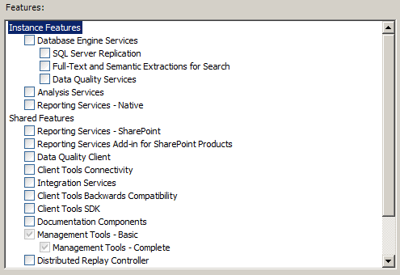
Introduction to In-Memory OLTP
How do we get it?
Notes:
Integrated in SQL Server 2014, no feature to install

Slide 8
(a couple) Limitations
Feature / Data Type | SQL Server 2014
Parallelism | Not supported
Clustered Indexes | Nope
Foreign Keys | Negative
Check Constraints | Can’t do that
Triggers | Nope
ALTER TABLE | Eeeuh…no (DROP + CREATE)
Compression | No
LOB Data Types | Nope
Columnstore Indexes | Not Supported
Table Size | 256GB
SQL Server 2016
Supported
Supported
Supported
Partially
Partially (through REBUILD)
Propably
Supported
2TB

Slide 9
Memory Optimization Advisor
Memory Optimization Advisor can help you convert ‘traditional’ tables to In-Memory tables
[ DEMO ]

Slide 10
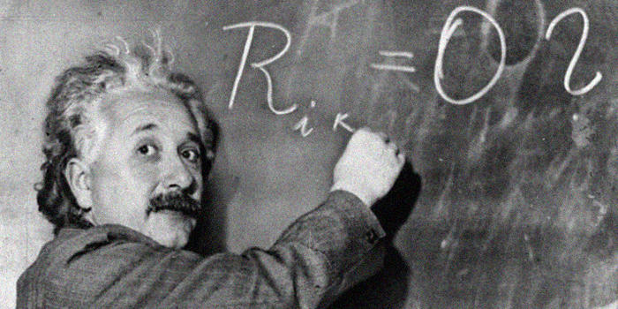
Memory-Optimized Table Theory

Slide 11
Memory-Optimized Table Theory
Reads and writes to In-Memory tables occur directly in the memory of your SQL Server Instance
Sounds scary? Don’t worry, In-Memory tables are fully durable (if you want them to)
There are some changes to transaction logging though:
Log records are generated when commit process begins
Changes to In-Memory indexes are not logged
Multiple changes will get grouped into one (large) log record
Notes:
Main focus of transaction log changes is optimizing throughput
For example, if the transaction has inserted 1000 rows and 50 rows can fit into a large log record, there will be total of 20 log records generated for memory-optimized tables instead of (at least) 1000

Slide 12
Memory-Optimized Table Theory
How is this durability achieved?
Memory-Optimized table data is stored in two files, a Data and Delta file
Data file contains rows of one or more Memory-Optimized tables
Delta file tracks deletes in the Data file
CFP
Data and Delta files are saved inside a seperate, Memory-Optimized, Filegroup
Notes:
CFP -> Checkpoint File Pair

Slide 13
Memory-Optimized Table Theory
Let’s take a closer look at the Data file
Characteristics:
No page structure like ‘traditional’ tables
Sequential access instead of random
Multiple Memory-Optimized tables can access one Data file
Data file
Table 1
row 1
transactions
Table 2
row 2
Table 1
row 3
Notes:
Rows are appended to the Data file in the order of transactions

Slide 14
Memory-Optimized Table Theory
Let’s take a closer look at the Data file
Data files have a maximum size of 128MB when there is more than 16GB RAM inside the server, 16MB when there is less then 16GB
Whenever a Data file is full, a new one is created together with a Delta file
Data and Delta files use transaction commit timestamps to keep track of the transactions inside the files
When a Data file is full, a new one is automatically created together with a new Delta file
Notes:
A new Data/Delta file will also be created after a CHECKPOINT

Slide 15
Memory-Optimized Table Theory
Let’s take a closer look at the Data file
0
∞
∞
100
101
Data file
Data file
Delta file
Delta file
CFP
CFP

Slide 16
Memory-Optimized Table Theory
What about those Delta files?
Delta files track rows that were deleted from the Data file, they are not directly removed from the Data file!
Eventually, rows that are marked as deleted in the Delta file will be removed from the Data file using a CFP Merge operation
Notes:
Merge is scheduled when 2 CFP’s can be consolidated so that 1 CFP can hold both

Slide 17
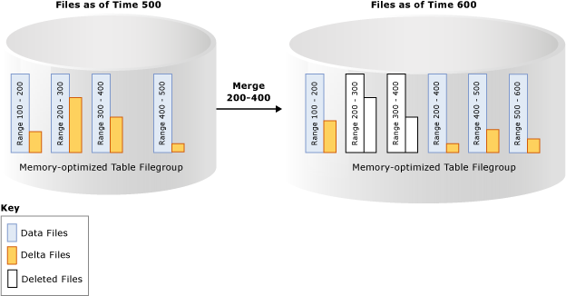
Memory-Optimized Table Theory
Source: https://msdn.microsoft.com/en-us/dn553125.aspx

Slide 18
Memory-Optimized Table Theory
In-Memory OLTP uses Snapshot-Based Transaction Isolation with Optimistic Concurrency control
This removes the need of locks and latches to protect transactions
Row versions are stored and maintained inside the Data files instead of TempDB
Notes:
Optimistic (assumes there are no conflicts) Snapshot Based Isolation There is a form of conflict detection active, if a conflict is detected the transaction will be terminated (rollback)

Slide 19

Memory-Optimized Table Theory

Slide 20
Creating Memory-Optimized Tables
[ DEMO ]

Slide 21
Hash Indexes
Indexes on Memory-Optimized tables need to be created in the CREATE TABLE statement
Indexes are not persisted on disk
Fragmentation does not matter for Memory-Optimized indexes
Memory-Optimized index types:
Non-Clustered
Non-Clustered Hash

Slide 22
Hash Indexes
Hash indexes do no use pages to save their data
Rows are stored in buckets
The bucket amount needs to be specified when creating the table
General guideline for bucket amount: 1-2 times number of distinct values for index key

Slide 23
Hash Indexes
So how do they work?
Hash Indexes use a hash function to place a row inside a specific bucket

Slide 24
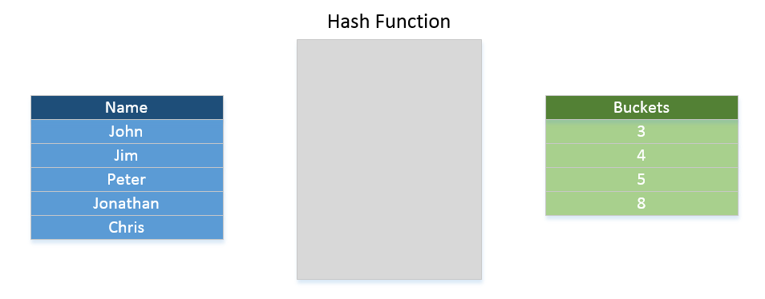
Hash Indexes
Peter = 5
Jim = 3
Chris = 5
Notes:
For this example, to keep things simple, let’s pretend the hash is the lenght of the name Whenever a two hashes have the same value a Hash Collision occurs. When this occurs SQL Server will chain the rows together

Slide 25
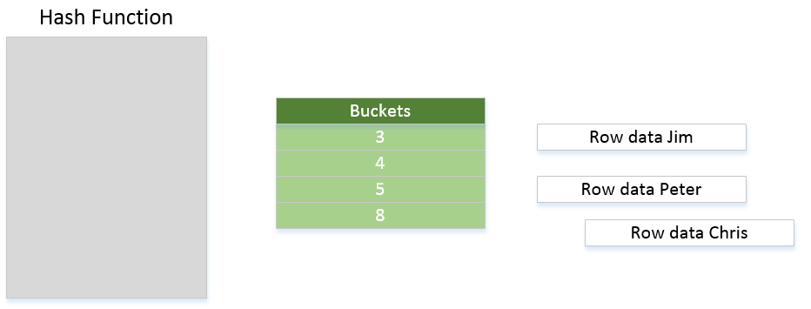

Hash Indexes
Peter = 5
Jim = 3
Chris = 5
Notes:
A large average chain length indicates that many rows are hashed to the same bucket. This could happen because:
If the number of empty buckets is low or the average and maximum chain lengths are similar, it is likely that the total bucket count is too low. This causes many different index keys to hash to the same bucket.
If the number of empty buckets is high or the maximum chain length is high relative to the average chain length, it is likely that there are many rows with duplicate index key values or there is a skew in the key values. All rows with the same index key value hash to the same bucket, hence there is a long chain length in that bucket

Slide 26
The End
End of Session

Slide 27
Sponsors
Gold Sponsors:
Bronze Sponsors:
Swag Sponsors:

